Slide 1
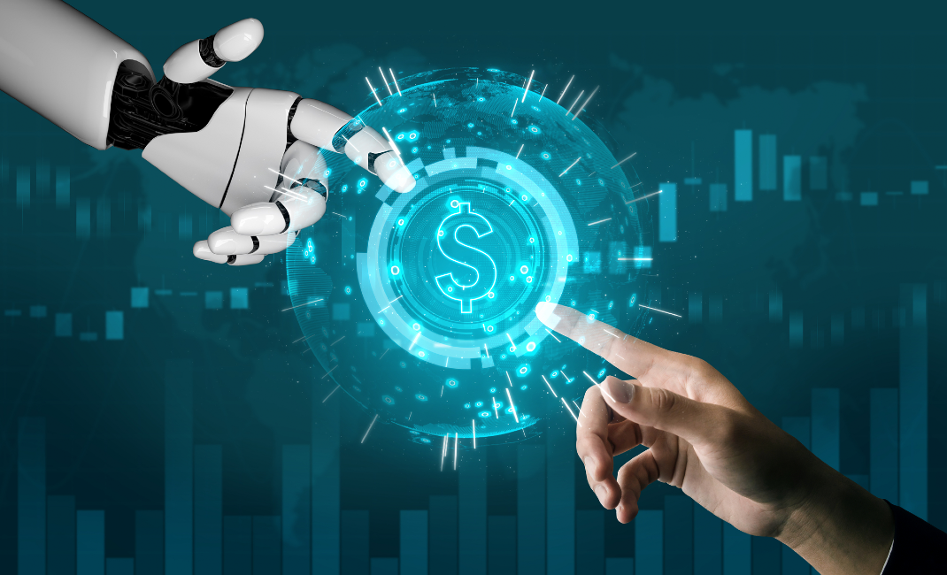
Fraud Detection For Banking
Sample Guys

Slide 2
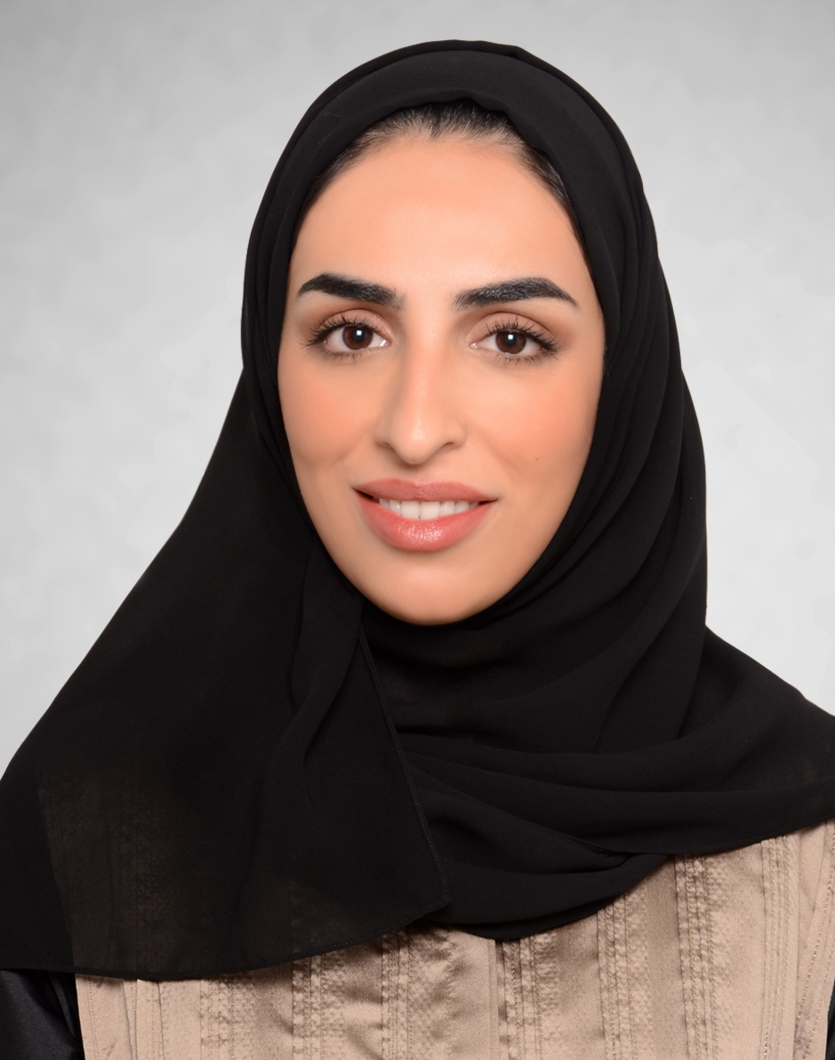



The Team
Maitha Alshaali
Information Security Analyst
Nafitha Najeeb
Finance Specialist
Hergen Meyer
Product Development Director
Dominique Duclayan
Profession

Slide 3


Slide 4
Problem Definition:
In this project, we are detecting fraudulent transactions from the Banksim dataset.
The Data Science Project we have selected deals with detecting fraudulent transactions and applying Machine Learning Model.
The source of the data is: https://www.kaggle.com/turkayavci/fraud-detection-on-bank-payments
The dataset consists of payments from various customers made in different time periods and with different amounts.

Slide 5
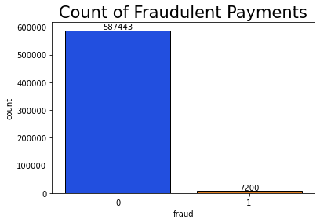

Slide 6
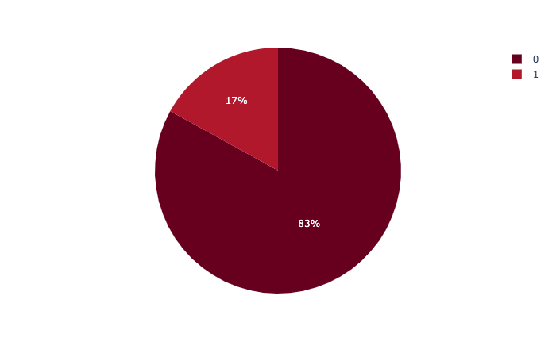
Percentage of amount of normal and fraud transactions
Fraud = 0
Normal = 1

Slide 7
2. Exploratory Data Analysis
The Dataset has 9 feature columns and a target column.
Feature Descriptions:
Step: This feature represents the day from the start of simulation. It has 180 steps so simulation ran for virtually 6 months.
Customer: This feature represents the customer id
zipCodeOrigin: The zip code of origin/source.
Merchant: The merchant's id
zipMerchant: The merchant's zip code

Slide 8
6. Age: Categorized age
0: <= 18,
1: 19-25,
2: 26-35,
3: 36-45,
4: 46:55,
5: 56:65,
6: > 65
U: Unknown
7. Gender: Gender for customer
E : Enterprise,
F: Female,
M: Male,
U: Unknown
8. Category: Category of the purchase.
9. Amount: Amount of the purchase
Fraud: Target variable which shows if the transaction fraudulent(1) or benign(0)

Slide 9
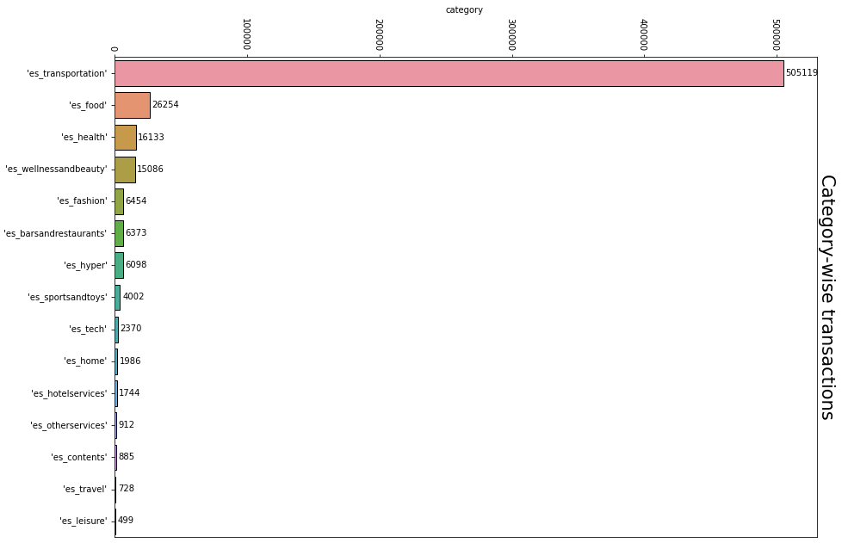

Slide 10
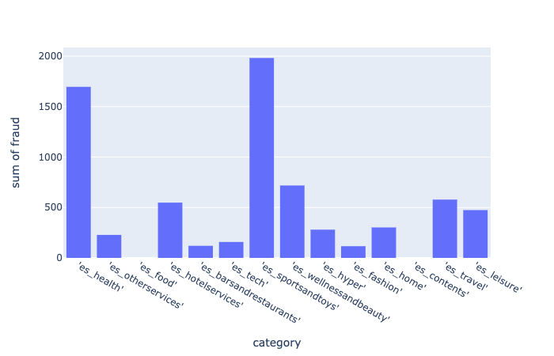

Slide 11
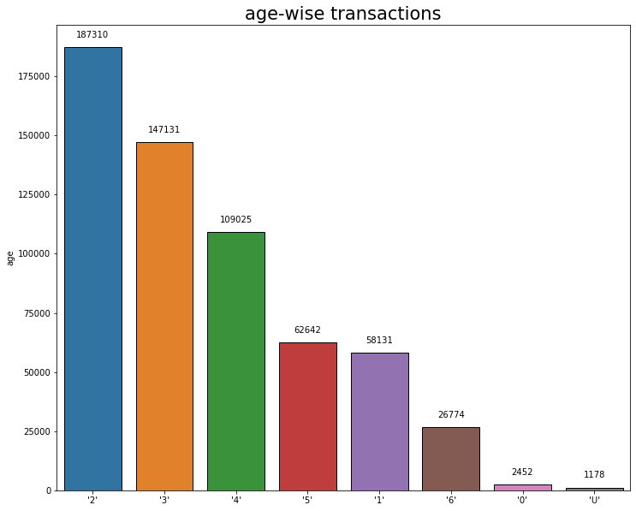
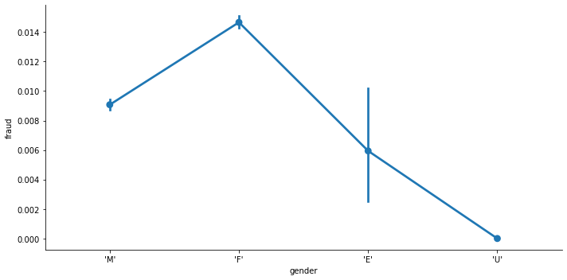

Slide 12
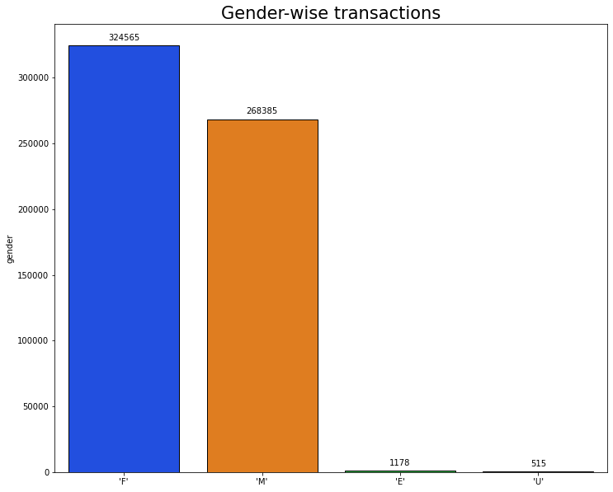

Slide 13
2. Exploratory Data Analysis
We started with analysing our dataset and found that there was no missing data. We checked the details of the fraud transactions and the correlation with different features like age, gender etc.
Age wise analysis showed that, the number of transaction and the number of fraud transactions were more in age group 2 that is 26-35.
Gender wise analysis revealed that the number of transactions were more in female category, E and U category being negligible
The two largest categories (es_transportation and es_food) have absolutely no fraud. Another pattern emerged was higher amount transactions has higher possibility of fraud.

Slide 14
EDA - Data Engineering
EDA and advanced EDA with Data cleaning and feature engineering were done.
One-hot encoding was done for ‘category’ feature as it was not numerical. Dimensions of the features were reduced.
Irrelevant features were dropped:
'step' - as there are only 20 repetitions
'customer' - everybody can be a victim.
'age' - no obvious correlation
'gender' - no obvious correlation
'zipMerchant' - same value for all entries
'zipcodeOri' - same value for all entries
'merchant' - not a good indicator,

Slide 15
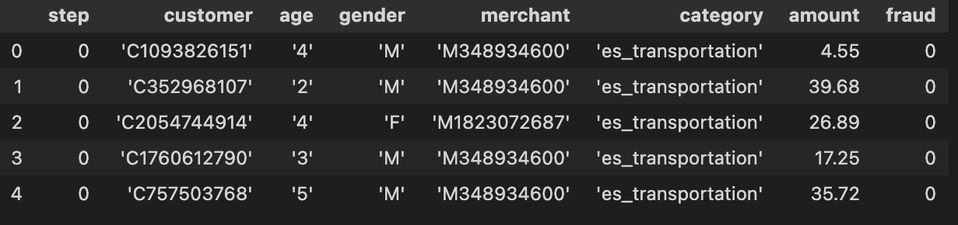
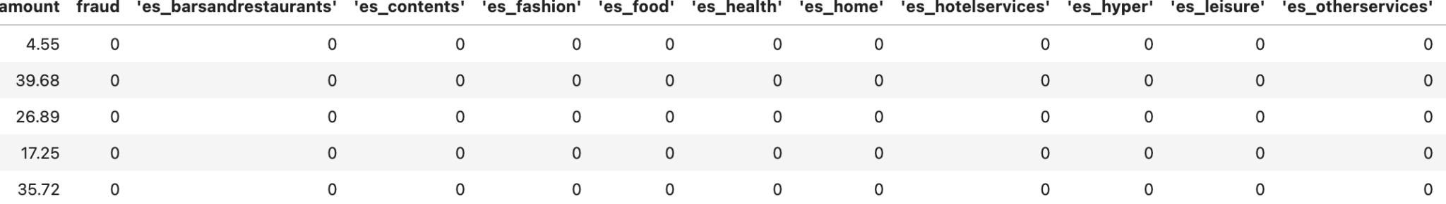
Data before EDA and Data Engineering
Data ready for Machine Learning after EDA and Data Engineering
Notes:
Slides for stages 1 and 2 upto EDA and Data Engineering done.

Slide 16
3. The Machine Learning Model
Neural Network

Slide 17
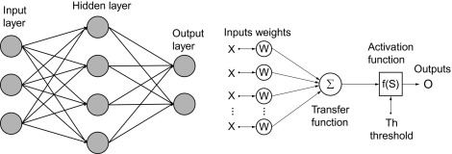

Slide 18
3. The Machine Learning Model
In this section, you will go over the following:
Neural Networks Model which comes under Deep Learning
The features of the model are amount of the transactions and the categories which different transaction fall into and label for the model is to predict which is fraud or not.
The reason you chose this ML model
How this model compares to other ML models
* For example: regression, classification, or clustering.

Slide 19
Results of Neural Network Model
Total Fraud Cases: 118929
Likely Fraud: 1692
Actual Fraud: 1134
This Model Is Able To Predict 0.95 % Of Fraud With An Accuracy Of 67.02%

Slide 20
Results of Neural Network Model

Slide 21
4. Machine Learning Analysis

Slide 22
4. Machine Learning Analysis
In this section, you will talk about the following:
The final metrics of the model
How you trained the model
The hyperparameters used
Other improvements that could be made the score

Slide 23
5. Conclusion

Slide 24
5. Conclusion
In this section, you will talk about the following:
The top 3 challenges you faced in the project
The top 3 lessons you learned in this project
Next steps for your data science career
Any comments you’d like to add!

Slide 25
6. Any Questions from Audience?

